Slide 1




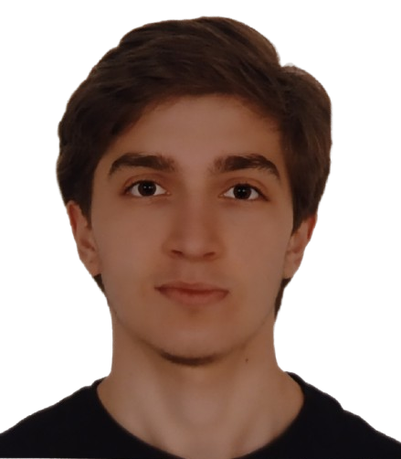
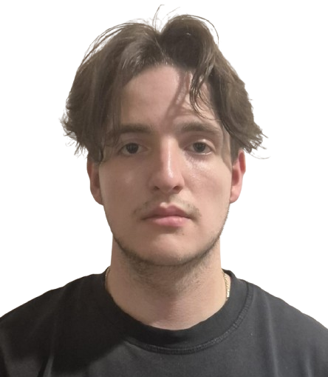
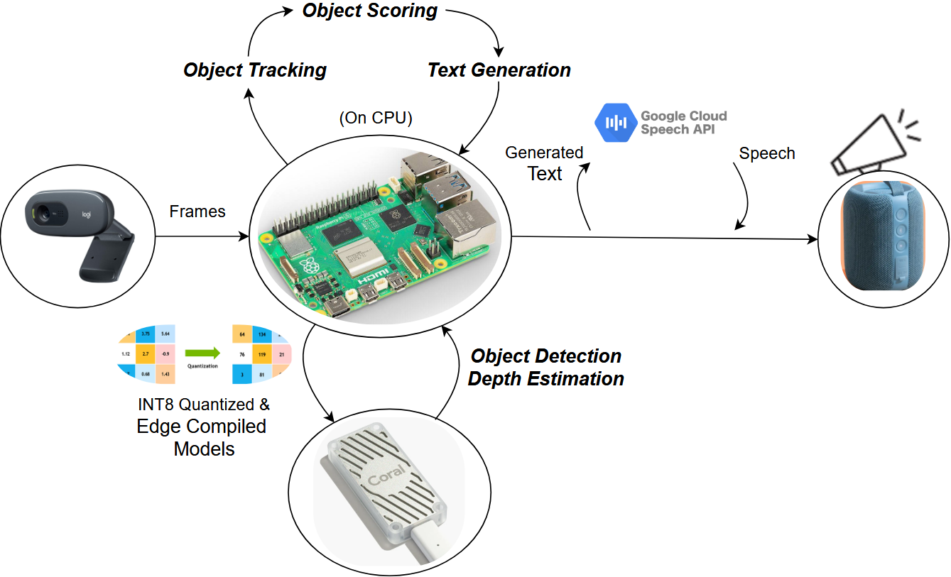
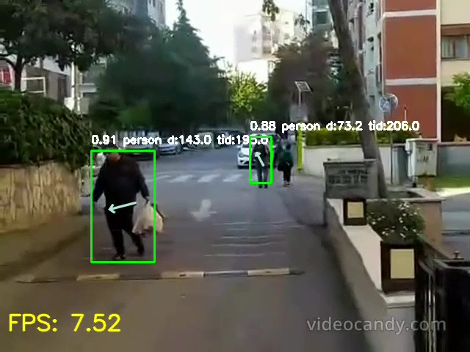
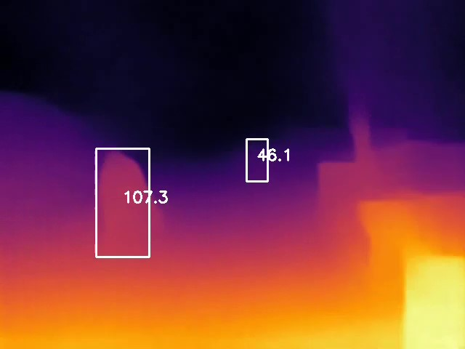
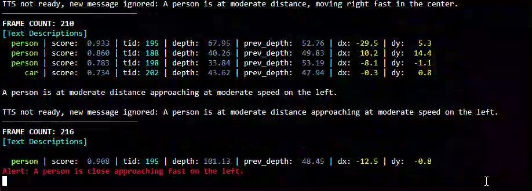
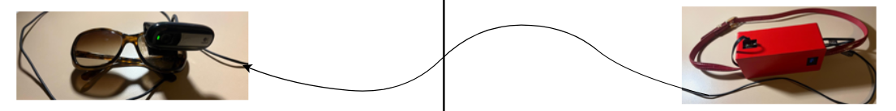
College of Engineering
Assistive Navigation Tool for Visually Impaired People Employing On-Device Learning
Students: Eren Gökmenler, Erem Onay Supervisor: Özgür Barış Akan Assistant: Melih Şahin
E-mail: egokmenler21@ku.edu.tr, eonay21@ku.edu.tr
Project Description
Group Members’ Photo
We developed a smart wearable assistant in the form of glasses that continuously detects surrounding objects in real time and provides audio feedback based on their depth and motion to enhance spatial awareness for visually impaired individuals.
"SuperScan” leverages real-time depth estimation and object detection on edge device using quantized neural networks accelerated by Edge TPU.
This enables fast, on-device decision making without server dependency, highlighting the potential of Edge AI in future assistive technologies.
Applications
(a)
(b)
(c)
Figure 1: Process of the System
Figure 2: (a) Object Detection & Tracking Output. (b) Depth Estimation Output.
(c) Object Scoring and Text Generation Output.
System Design
Module Integration
The system continuously receives input from a USB camera mounted on glasses. Each frame is processed locally on a Raspberry Pi 5 using lightweight neural networks accelerated by the Edge TPU for object detection (SSD MobileNet V2) and depth estimation (MiDaS V2).
A motion tracking module (SORT) calculates object displacement across frames, while a custom object scoring module assigns risk scores based on class, depth, and motion.
The text generation module selects the highest-risk object every 10 frames and formulates a descriptive sentence.
This sentence is then converted into real-time speech using the Google TTS module.
All inference is performed fully on-device with no cloud dependency, achieving under-120ms end-to-end latency.
To ensure timely response in critical situations, an early alert mechanism bypasses the 10-frame scoring cycle if any object’s risk score exceeds a predefined threshold, triggering immediate feedback.
A USB Camera is connected and streamed using GStreamer multimedia framework for low-latency and efficient frame capture with minimal CPU usage.
The Google Coral Edge TPU connects via USB and runs EdgeTPU-Compiled INT8 TFLite models.
Audio output is sent via Bluetooth, providing wireless voice feedback without cables.
The “MobileNet-SSD V2” and “MiDaS V2” models, originally trained in PyTorch/TensorFlow, were quantized to INT8, converted to TensorFlow Lite format, and compiled using the EdgeTPU Compiler to enable fast and power-efficient inference on the Google Coral USB Accelerator.
Figure 3: Model Conversion Process for Edge TPU Compatibility
References:
[1] D. Cantero, I. Esnaola-Gonzalez, J. Miguel-Alonso, and E. Jauregi, “Benchmarking Object Detection Deep Learning Models in Embedded Devices,” Sensors, vol. 22, no. 11, p. 4205, 2022, doi: 10.3390/s22114205.
[2] A. Bewley, Z. Ge, L. Ott, F. Ramos, and B. Upcroft, “Simple Online and Realtime Tracking,” in Proc. IEEE Int. Conf. Image Process. (ICIP), 2016, pp. 3464–3468. doi: 10.1109/ICIP.2016.7533003

